Slide 1
Investigate Hotel Business using Data Visualization

Slide 2



Muhammad Ifzal Asril
linkedin.com/in/ifzalasril
zalasril28@gmail.com
+6289506695859

Slide 3
Table of contents
01
02
03
About Dataset
Data Preparation
Data Visualization

Slide 4
01
About Dataset
Import dataset and libraries needed for analysis.

Slide 5





What Kind of Tools are Used ?

Slide 6
About Dataset
This section contains information about the dataset used.

Slide 7
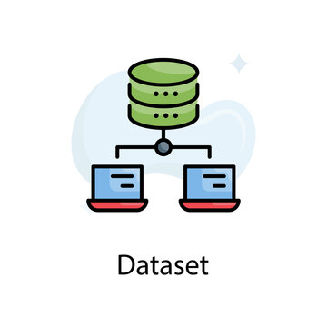
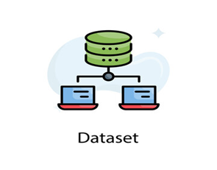
Columns
Data Type
29
3
Rows
Missing Values
119.390
4

Slide 8
Columns
Hotel | Children | Reservation Status
Is Canceled | Babies | Deposit Type
Lead Time | Meal | Agent
Arrival Date Year | City | Company
Arrival Date Month | Market Segment | Days in Waiting List
Arrival Date Week Number | Distribution Channel | Customer Type
Arrival Date Day of Month | Is Repeated Guests | Adr
Stays in Weekend Nights | Previous Cancellations | Required Car Parking Spaces
Stays in Weekdays Nights | Previous Bookings not Canceled | Total of Special Requests
Adults | Booking Changes

Slide 9
02
Data Preparation
Data preparation is the process of preparing raw data so that it is suitable for further processing and analysis.

Slide 10

Duplicated Data
33.261 Rows
Missing Data
Company | 112.593 Rows
Agent | 16.340 Rows
City | 488 Rows
Children | 4 Rows
4 Columns

Slide 11


Slide 12
Columns After Feature Engineering
Hotel | Children | Reservation Status
Is Canceled | Babies | Deposit Type
Lead Time | Meal | Agent
Arrival Date Year | City | Company
Arrival Date Month | Market Segment | Days in Waiting List
Arrival Date Week Number | Distribution Channel | Customer Type
Arrival Date Day of Month | Is Repeated Guests | Adr
Stays in Weekend Nights | Previous Cancellations | Required Car Parking Spaces
Stays in Weekdays Nights | Previous Bookings not Canceled | Total of Special Requests
Adults | Booking Changes
Total Guests
Stay Duration

Slide 13
—Someone Famous
“This is a quote, words full of wisdom that someone important said and that can inspire the reader”

Slide 14
03
Data Visualization
Data visualization is the representation of data through use of common graphics, such as charts, plots, infographics, and even animations.

Slide 15
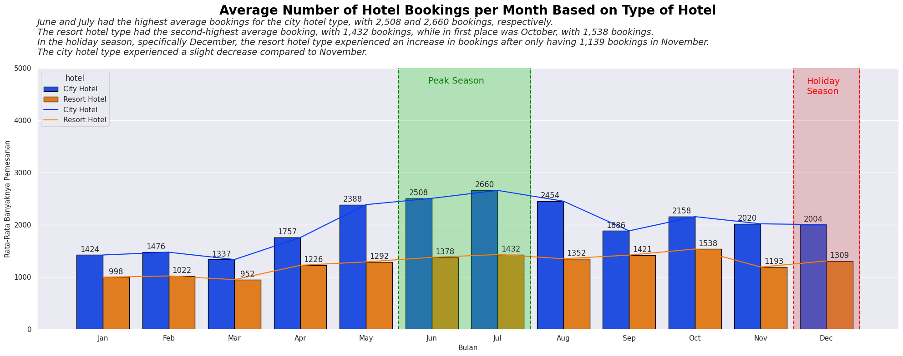

Slide 16
2.508 & 2.660
June and July had the highest average bookings for the city hotel type, with 2,508 and 2,660 bookings

Slide 17
1.432 & 1.538
The resort hotel type had the second-highest average booking, with 1,432 bookings, while in first place was October, with 1,538 bookings.

Slide 18
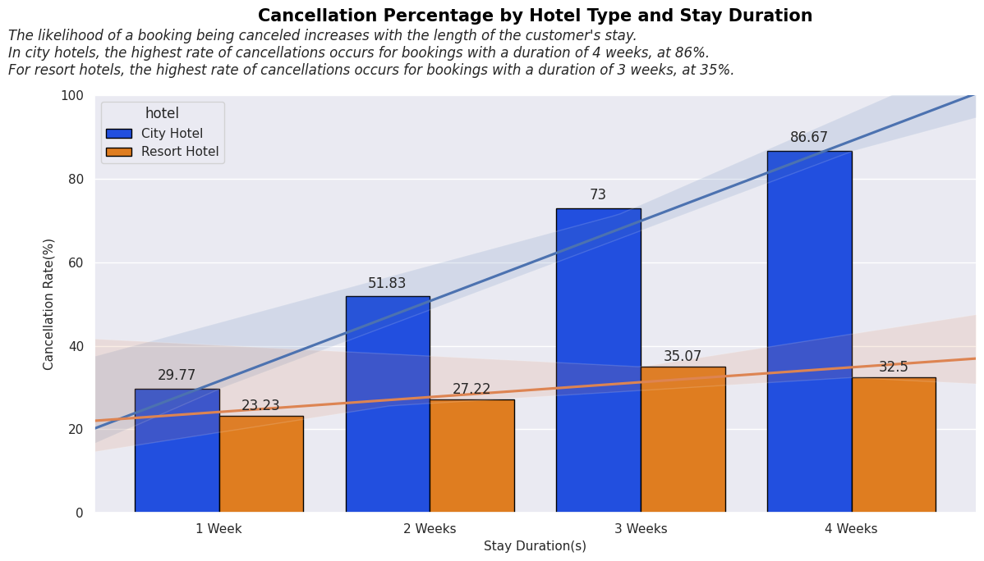

Slide 19
86 %
35 %
In city hotels, the highest rate of cancellations occurs for bookings with a duration of 4 weeks, at 86%.
For resort hotels, the highest rate of cancellations occurs for bookings with a duration of 3 weeks, at 35%.

Slide 20
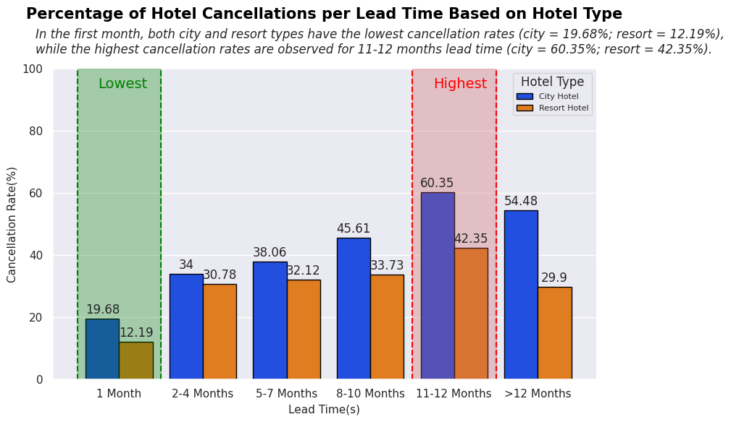

Slide 21


Lowest Cancellation Rates
19,68 %
12,19%
City Hotel
Resort Hotel

Slide 22
Muhammad Ifzal Asril

